Slide 1
How Do We Compare Biological Sequences? Dynamic Programming and Divide-and Conquer Algorithms
Phillip Compeau and Pavel Pevzner.
Bioinformatics Algorithms: An Active Learning Approach
Cap. 6

Slide 2
From a Game to a Definition
Given two strings v and w, an alignment of v and w is a two-row matrix such that:
the first row contains symbols of v
the second row contains symbols of w
each row may also contain gap symbols (“-”)
no column has two gap symbols
AT-GTTATA
ATCGT-C-C

Slide 3
From a Game to a Definition
Given two strings v and w, an alignment of v and w is a two-row matrix such that:
the first row contains symbols of v
the second row contains symbols of w
each row may also contain gap symbols (“-”)
no column has two gap symbols
AT-GTTATA
ATCGT-C-C
Matches

Slide 4
From a Game to a Definition
Given two strings v and w, an alignment of v and w is a two-row matrix such that:
the first row contains symbols of v
the second row contains symbols of w
each row may also contain gap symbols (“-”)
no column has two gap symbols
AT-GTTATA
ATCGT-C-C
Mismatches

Slide 5
From a Game to a Definition
Given two strings v and w, an alignment of v and w is a two-row matrix such that:
the first row contains symbols of v
the second row contains symbols of w
each row may also contain gap symbols (“-”)
no column has two gap symbols
AT-GTTATA
ATCGT-C-C
Insertions

Slide 6
From a Game to a Definition
Given two strings v and w, an alignment of v and w is a two-row matrix such that:
the first row contains symbols of v
the second row contains symbols of w
each row may also contain gap symbols (“-”)
no column has two gap symbols
AT-GTTATA
ATCGT-C-C
Deletions

Slide 7
Recap
matches insertions deletions mismatches
A T - G T T A T A
A T C G T - C - C
+1+1 +1+1 =4
Alignment of two sequences is a two-row matrix:
1st row: symbols of the 1st sequence (in order) interspersed by “-”
2nd row: symbols of the 2nd sequence (in order) interspersed by “-”

Slide 8
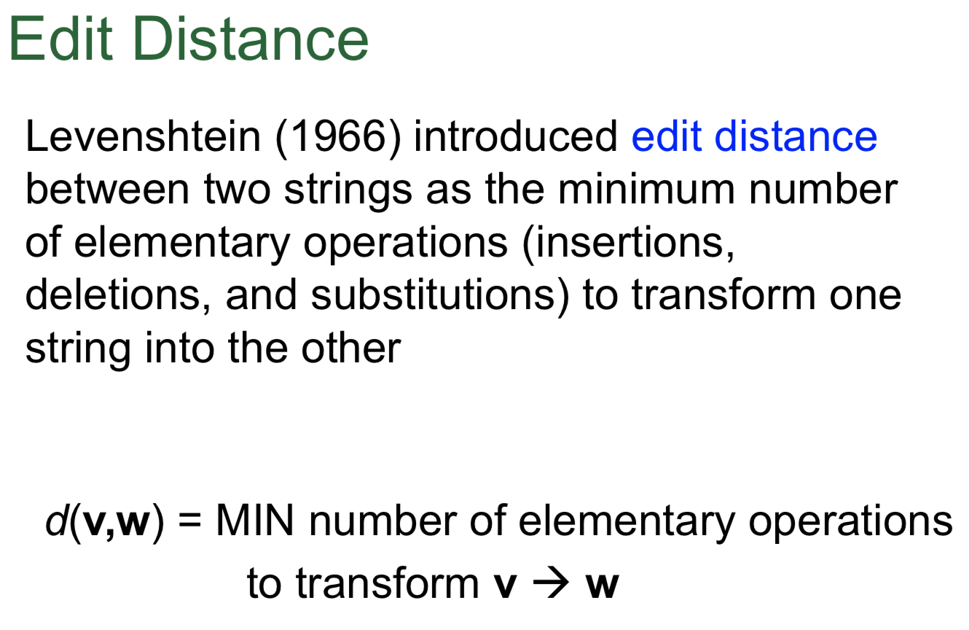

Slide 9
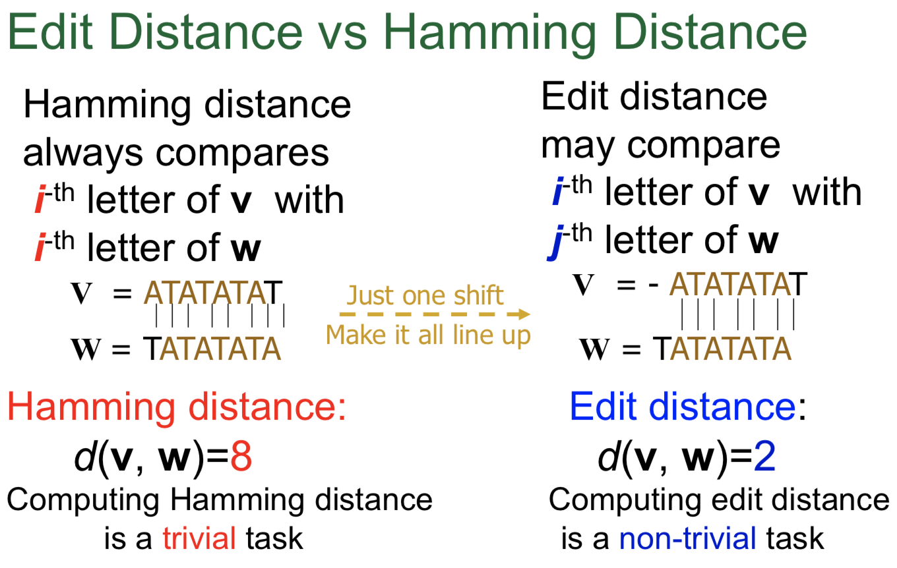

Slide 10
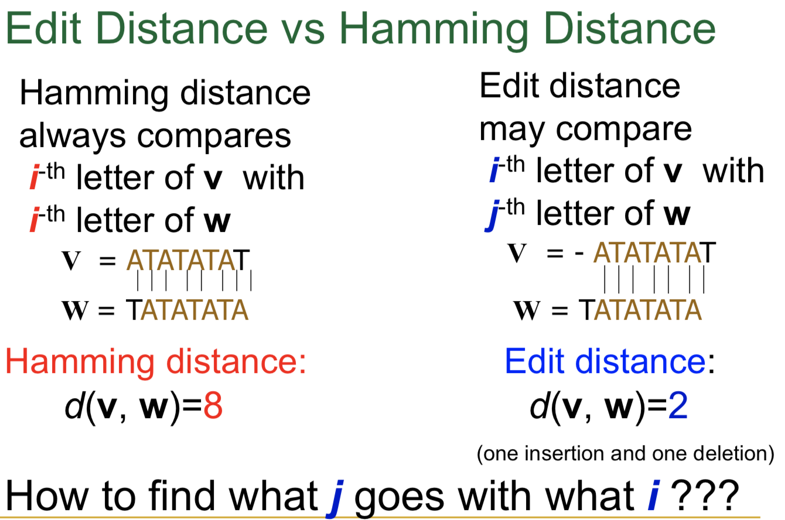

Slide 11
Finding a Longest Common Subsequence
A common subsequence of v and w is a sequence of symbols occurring (not necessarily contiguously) in both v and w.

Slide 12

Finding a Longest Common Subsequence
A common subsequence of v and w is a sequence of symbols occurring (not necessarily contiguously) in both v and w.
The matches in an alignment of v and w form a common subsequence of v and w.
AT-GTTATA
ATCGT-C-C
miglior allineamento … massimo numero di matches

Slide 13
The Problems are the Same!
Longest Common Subsequence Length Problem:.
Input: Two strings.
Output: The length of a longest common subsequence of these strings.
Symbol Matching Problem:
Input: Two strings.
Output: The greatest number of matched symbols in any “alignment” of the two strings.

Slide 14
How Do We Compare Biological Sequences
From Sequence Comparison to Biological Insights
The Alignment Game and the Longest Common Subsequence
The Manhattan Tourist Problem
The Change Problem
Dynamic Programming and Backtracking Pointers
From Manhattan to the Alignment Graph
From Global to Local Alignment
Penalizing Insertions and Deletions in Sequence Alignment
Space-Efficient Sequence Alignment
Multiple Sequence Alignment

Slide 15
From Manhattan to a Grid Graph
Walk from the source to the sink (only in the South ↓ and East → directions) and visit the maximum number of attractions

Slide 16
Manhattan Tourist as a Network (Grid)
Weight of edge: number of attractions along the edge.
Goal: Find a longest path from source (top left) to sink (bottom right).

Slide 17
Toward a Computational Problem
Manhattan Tourist Problem:
Input: A weighted n x m rectangular grid (n + 1 rows and m + 1 columns).
Output: A longest path from source (0, 0) to sink (n, m) in the grid.

Slide 18
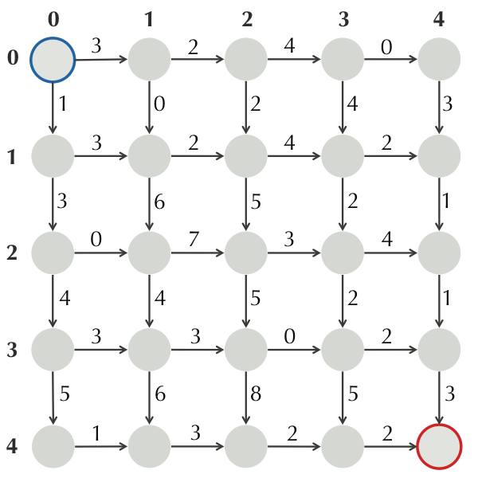
Designing a Manhattan Algorithm
Exercise: What is the longest path in this city? What algorithm did you use?

Slide 19
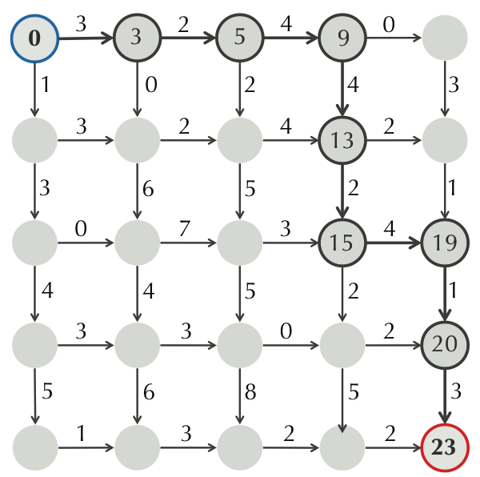
A “Greedy” Manhattan Algorithm Taking the Best Choice in Each Node
STOP: Does the greedy algorithm solve the problem?

Slide 20
A “Greedy” Manhattan Algorithm Taking the Best Choice in Each Node
Answer: No!

Slide 21
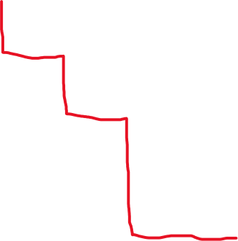
A “Greedy” Manhattan Algorithm Taking the Best Choice in Each Node
Answer: No! We need a more clever approach.

Slide 22
3
2
4
0
5
1
4
2
3
From a regular to an irregular grid
4
3
2
4
2
3
6
5
1
0
7
2
3
4
4
4
4
6
2
1
3
3
0
2
5
6
8
5
3
1
3
2
2

Slide 23
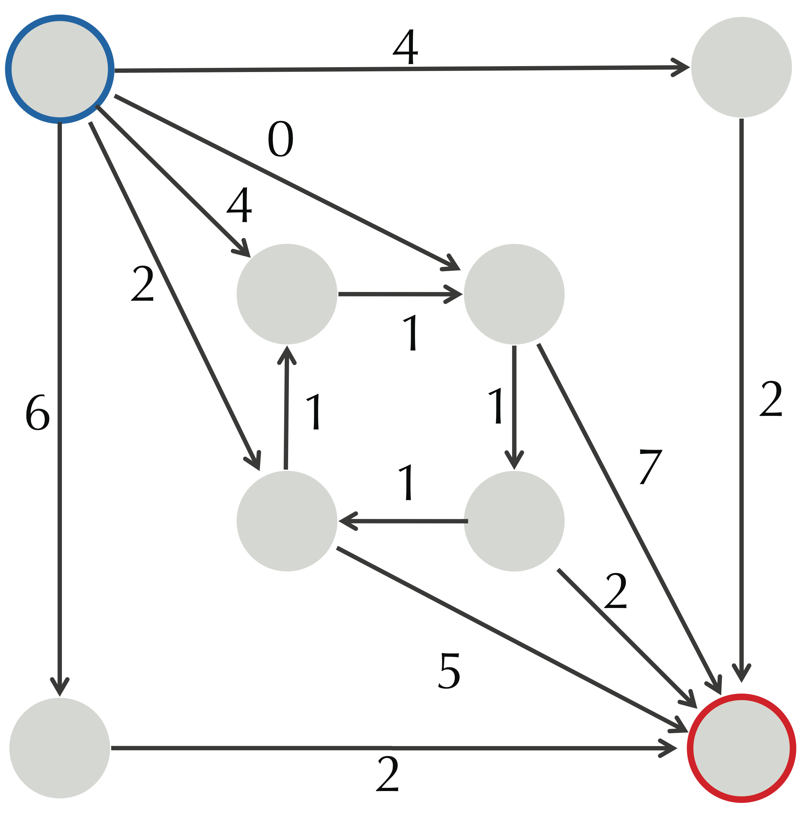
Manhattan Tourist as a Network Problem
STOP: What is the longest path in this graph?

Slide 24
Manhattan Tourist as a Network Problem
Answer: Cycles in graphs cause infinite paths ...

Slide 25
Generalizing Manhattan Tourist
Directed acyclic graph (DAG): A directed graph that contains no cycles.
Longest Path in a DAG Problem:
Input: An edge-weighted DAG with source and sink nodes.
Output: A longest path from source to sink in the DAG.
... but what does finding a longest path in a DAG have to do with sequence comparison?

Slide 26
Sequence Alignment as a Path in a Network

Slide 27
Returning to Sequence Alignment ...
the number of symbols present up to a given position

Slide 28
Returning to Sequence Alignment ...
the number of symbols present up to a given position
(0, 0) ↘ (1, 1) ↘ (2, 2) → (2, 3) ↘ (3, 4) ↘ (4, 5)↓(5, 5) ↘ (6, 6)↓(7, 6) ↘ (8, 7)
This is a path in a 2-D network!

Slide 29
Representing an Alignment as a Path in a Manhattan-like DAG
↘ ↘ → ↘ ↘ ↓↘ ↓↘
AT-GTTATA
ATCGT-C-C
This network is called the alignment network of the strings ATGTTATA and ATCGTCC.

Slide 30
We can also construct an alignment from a path
Exercise: What alignment does this path correspond to?
Answer:
ATGTTA-T--A
--AT-CGTCC-

Slide 31
Recall that these problems are the same
Symbol Matching Problem:
Input: Two strings.
Output: The greatest number of matched symbols in any “alignment” of the two strings.
Longest Common Subsequence Length Problem:.
Input: Two strings.
Output: The length of a longest common subsequence of these strings.

Slide 32
Solving the Symbol Matching Problem
Symbol Matching Problem:
Input: Two strings.
Output: The greatest number of matched symbols in any alignment of the two strings.
STOP: How can we use the alignment network to solve this problem (and so LCS)?
by using suitable weights!

Slide 33
Counting Matches Only
Answer: If we weight the red edges as 1 and the other edges as 0, then a maximum-weight path from source to sink solves the Symbol Matching Problem!
But we haven’t said how to find the maximum length of a path.

Slide 34
How Do We Compare Biological Sequences
From Sequence Comparison to Biological Insights
The Alignment Game and the Longest Common Subsequence
The Manhattan Tourist Problem
Dynamic Programming and Backtracking Pointers
From Manhattan to the Alignment Graph
From Global to Local Alignment
Penalizing Insertions and Deletions in Sequence Alignment
Space-Efficient Sequence Alignment
Multiple Sequence Alignment

Slide 35
3
2
4
0
There are only 2 ways to arrive to the sink:
by moving South ↓
or by moving East →
1
0
2
4
3
3
2
4
2
3
6
5
2
1
0
7
3
3
4
4
5
2
1
3
3
0
2
5
6
8
5
3
South or East?
1
3
2
2
Notes:
scratch

Slide 36
3
2
4
0
There are only 2 ways to arrive to the sink:
by moving South ↓
or by moving East →
1
0
2
4
3
3
2
4
2
DOMANDA: QUAL E’ IL MODO «MIGLIORE» PER COLLEGARE IL NODO DI PARTENZA AL NODO DI ARRIVO?
3
6
5
2
1
0
7
3
3
4
4
5
2
1
3
3
0
2
5
6
8
5
3
South or East?
1
3
2
2
Notes:
scratch

Slide 37
3
2
4
0
There are only 2 ways to arrive to the sink:
by moving South ↓
or by moving East →
1
0
2
4
3
3
2
4
2
DOMANDA: QUAL E’ IL MODO «MIGLIORE» PER COLLEGARE IL NODO DI PARTENZA AL NODO DI ARRIVO?
- NATURA RICORSIVA DEL PROBLEMA… -
3
6
5
2
1
0
7
3
3
4
4
5
2
1
3
3
0
2
5
6
8
5
3
South or East?
1
3
2
2
Notes:
scratch

Slide 38
South or East?
path migliore da (0,0) a (n,m)
SouthOrEast(n,m)
if n=0 and m=0
return 0
if n>0 and m>0
x ← SouthOrEast(n-1,m)+weight of edge “↓”into (n,m)
y ← SouthOrEast(n,m-1)+ weight of edge “→”into (n,m)
return max{x,y}
return -infinity
Recursive solution… makes a lot of recursive calls for a fixed n and m… Dynamic programming!

Slide 39
3
2
4
0
0
3
5
9
9
1
0
2
4
3
Qui non abbiamo scelte: non c’è altro modo di raggiungere questi nodi…
3
2
4
2
1
4
6
5
2
1
0
7
3
3
5
4
4
5
2
1
3
3
0
2
9
5
6
8
5
3
1
3
2
2
14
Notes:
Figure 5

Slide 40
3
2
4
0
0
3
5
9
9
South or East?
1
0
2
4
3
3
2
4
2
1
4
1+3 > 3+0
4
6
5
2
1
0
7
3
3
5
4
4
5
2
1
3
3
0
2
9
5
6
8
5
3
1
3
2
2
14
Notes:
Figure 5

Slide 41
3
2
4
0
0
3
5
9
9
1
0
2
4
3
3
2
4
2
1
4
7
13
15
4
6
5
2
1
0
7
3
3
5
10
17
20
24
4
4
5
2
1
3
3
0
2
9
14
22
22
25
5
6
8
5
3
1
3
2
2
14
20
30
32
34
Notes:
Figure 8a

Slide 42
3
2
4
0
0
3
5
9
9
1
2
4
Backtracking pointers:
the best way to get to each node
3
2
1
4
7
13
15
4
6
7
3
3
5
10
17
20
24
4
4
5
2
1
0
9
14
22
22
25
5
6
8
2
2
14
20
30
32
34
Notes:
Figure 8a

Slide 43
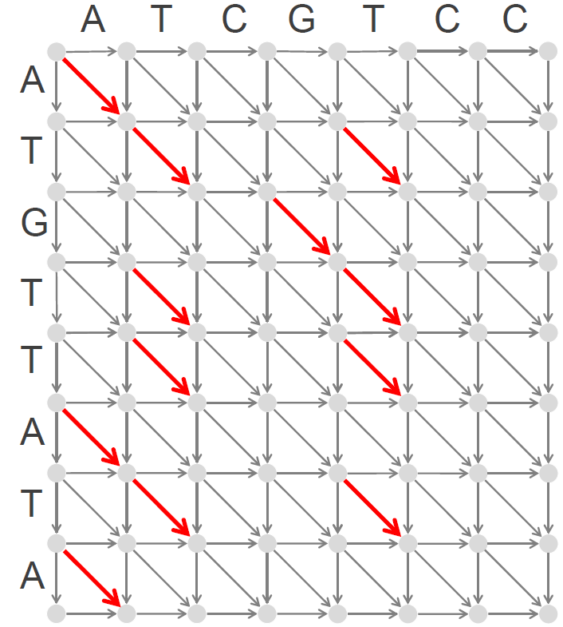
Dynamic Programming Recurrence for the Alignment Graph
s_{i, j}: the length of a longest path from (0,0) to (i,j)
s_{i-1, j} + weight of edge “↓” into (i,j)
s_{i, j-1} + weight of edge “→” into (i,j)
s_{i-1, j-1}+ weight of edge “↘” into (i,j)
{
s_{i, j}= max
weights?

Slide 44
Dynamic Programming Recurrence for the Alignment Graph - Counting Matches Only
s_{i, j}: the length of a longest path from (0,0) to (i,j)
s_{i-1, j} + weight of edge “↓” into (i,j)
s_{i, j-1} + weight of edge “→” into (i,j)
s_{i-1, j-1}+ weight of edge “↘” into (i,j)
{
s_{i, j}= max
red edges ↘ – weight 1
other edges – weight 0

Slide 45
Dynamic Programming Recurrence for the Longest Common Subsequence Problem
s_{i, j}: the length of a longest path from (0,0) to (i,j)
s_{i-1, j} + 0
s_{i, j-1} + 0
s_{i-1, j-1}+ 1, if v_{i}=w_{j}
{
s_{i, j}= max
red edges ↘ – weight 1
other edges – weight 0

Slide 46
Computing Backtracking Pointers
s_{i,j-1}+0
s_{i,j} ← max{ s_{i-1,j}+0
s_{i-1,j-1}+1, if v_{i}=w_{j}
“→”, if s_{i,j}=s_{i,j-1}
backtrack_{i,j} ← {“↓", if s_{i,j}=s_{i-1,j}
“↘”, if s_{i,j}=s_{i-1,j-1}+1

Slide 47
Putting it All Together
Longest Common Subsequence Length Problem:.
Input: Two strings.
Output: The length of a longest common subsequence of these strings.
Answer:
Build the alignment graph, with ”match” edges weighted 1.
Find the length of an LCS using recurrence relation.
Backtrack to find longest path.

Slide 48
Current (Primitive) Scoring
#matches
edit distance?
Longest Common Subsequence (higher #matches, but biologically inadequate)…
Marahiel’s (biologically adequate) alignment

Slide 49
Mismatches and Indel Penalties
penalties
#matches − μ · #mismatches − σ · #indels
A T - G T T A T A
A T C G T - C – C
+1+1-2+1+1-2-3-2-3=-7
biologically adequate
Gap (indel): evolutionary event or a desease
(talassemia: mutazione genetica)

Slide 50
Mismatches and Indel Penalties
penalties
#matches − μ · #mismatches − σ · #indels
A T - G T T A T A
A T C G T - C – C
+1+1-2+1+1-2-3-2-3=-7
How to find an optimal solution of the alignment game and an optimal alignment under this model?

Slide 51
Mismatches and Indel Penalties
penalties
#matches − μ · #mismatches − σ · #indels
A T - G T T A T A
A T C G T - C – C
+1+1-2+1+1-2-3-2-3=-7
A C G T −
A +1 −μ −μ −μ -σ
C −μ +1 −μ −μ -σ
G −μ −μ +1 −μ -σ
T −μ −μ –μ +1 -σ
− -σ -σ -σ -σ
A C G T −
A +1 −3 −5 −1 -3
C −4 +1 −3 −2 -3
G −9 −7 +1 −1 -3
T −3 −5 –8 +1 -4
− -4 -2 -2 -1
Scoring matrix
Even more general scoring matrix
(rare case)

Slide 52
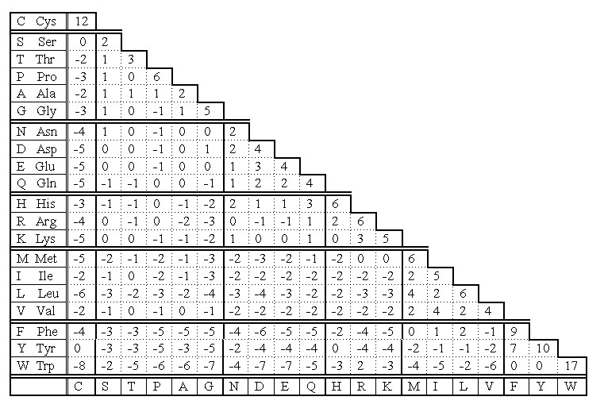
Scoring Matrices for Amino Acid Sequences
reflects the frequency with which amino acid x replaces y in evolutionarily related sequences
Y (Tyr) often mutates into F (score +7)
but rarely mutates into P (score -5)
-5
7

Slide 53
Global Alignment
Global Alignment Problem: Find the highest-scoring alignment between two strings by using a scoring matrix.
Input: Strings v and w as well as a matrix score.
Output: An alignment of v and w whose alignment score (as defined by the scoring matrix score) is maximal among all possible alignments of v and w.
Global Alignment Problem:
good model for some biological sequence comparison problems,
but bad model for others...

Slide 54
Strengthening Alignment Scoring
Alignment score: Divided into three components:
match reward (+1)
mismatch penalty (-μ)
insertion/deletion penalty (-σ)
Answer: They were both equal to zero…
STOP: How can we modify the alignment network to solve this problem?

Slide 55
Strengthening Alignment Scoring
Answer: Slight modification to alignment network ... a longest path will yield an alignment of maximum score!

Slide 56
Strengthening Alignment Scoring
Answer: Slight modification to alignment network ... a longest path will yield an alignment of maximum score!
Exercise: What is the recurrence relation?

Slide 57
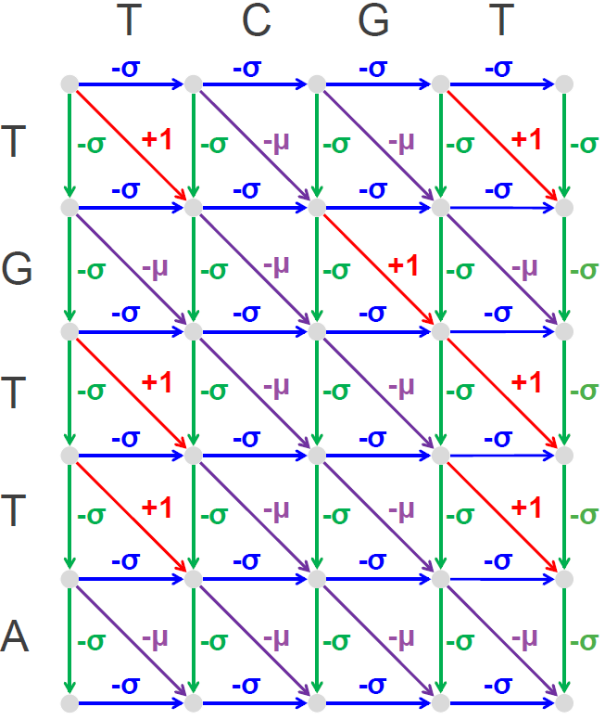
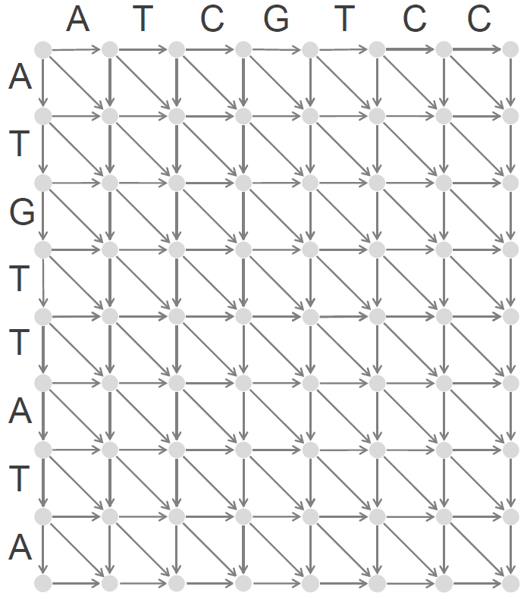
Dynamic Programming Recurrence for the Alignment Graph
s_{i-1, j} - σ
s_{i, j-1} - σ
s_{i-1, j-1} + 1, if v_{i}=w_{j}
s_{i-1, j-1} - μ, if v_{i}≠w_{j}
gap
s_{i, j}= max
match/mismatch

Slide 58
Dynamic Programming Recurrence for the Alignment Graph
s_{i-1, j} + score(v_{i},-)
s_{i, j-1} + score(-,w_{j})
s_{i-1, j-1}+ score(v_{i},w_{j})
{
s_{i, j}= max

Slide 59
Further Strengthening Scoring with a Scoring Matrix
PAM250 (Percent Accepted Mutations) matrix
Scoring matrix: Penalizes indels and matches/mismatches differently depending on individual symbols.
STOP: How do you think this matrix was computed?
The matrix is frequently used to score aligned peptide sequences to determine the similarity of those sequences. The numbers given above were derived from comparing aligned sequences of proteins with known homology and determining the "accepted point mutations" (PAM) observed.

Slide 60
PAM vs. BLOSUM
Rappresentano la distanza evolutiva tra aminoacidi

Slide 61
PAM vs. BLOSUM
percent accepted mutation
PAMx: la probabilità con cui ogni aminoacido subisce x sostituzioni su 100 amino acidi (percentuale di mutazioni accettate).
se si vogliono confrontare sequenze filogeneticamente vicine (si può ipotizzare un numero limitato di sostituzioni) sarà opportuno usare una matrice PAM a basso indice
Blocks Substitution Matrix
Si confrontarono 71sequenze proteiche «vicine» (1979).
Per ciascun aminoacido j si contano tutti i cambiamenti in un altro aminoacido k. Si normalizza la frequenza dividendo per il totale dei cambiamenti.

Slide 62
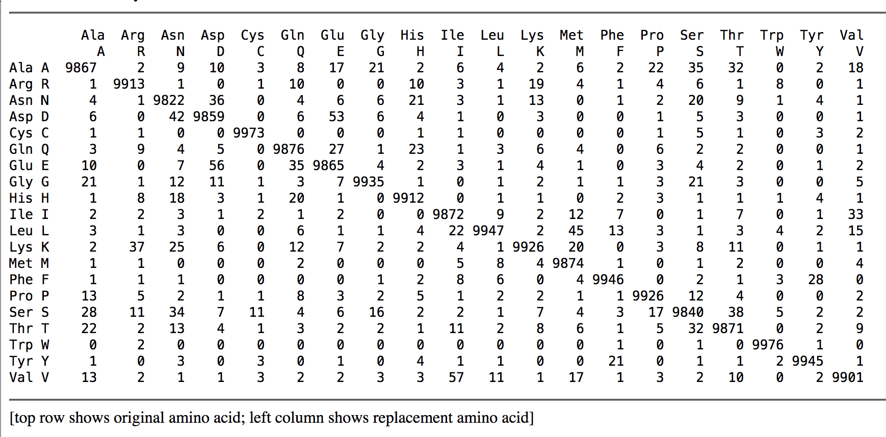
PAM vs. BLOSUM
percent accepted mutation
PAMx: la probabilità con cui ogni aminoacido subisce x sostituzioni su 100 amino acidi (percentuale di mutazioni accettate).
Blocks Substitution Matrix
PAM1
in general, it gives the probability that the amino acid in column j will be replaced by the amino acid in row i after a given evolutionary interval
(qui 1PAM)

Slide 63
PAM vs. BLOSUM
percent accepted mutation
PAMx: la probabilità con cui ogni aminoacido subisce x sostituzioni su 100 amino acidi (percentuale di mutazioni accettate).
se si vogliono confrontare sequenze filogeneticamente vicine (si può ipotizzare un numero limitato di sostituzioni) sarà opportuno usare una matrice PAM a basso indice
Blocks Substitution Matrix
BLOSUMx: osservo sequenze con almeno x% identità e valuto la «distanza» tra le altre.
Based on local alignments.
Based on observed alignments; they are not extrapolated from comparisons of closely related proteins.
Larger numbers in matrices naming scheme denote higher sequence similarity, therefore smaller evolutionary distance.
Based on global alignments of closely related proteins (Derived from phylogenetic trees).
Higher numbers in matrices naming scheme denote larger evolutionary distance.

Slide 64
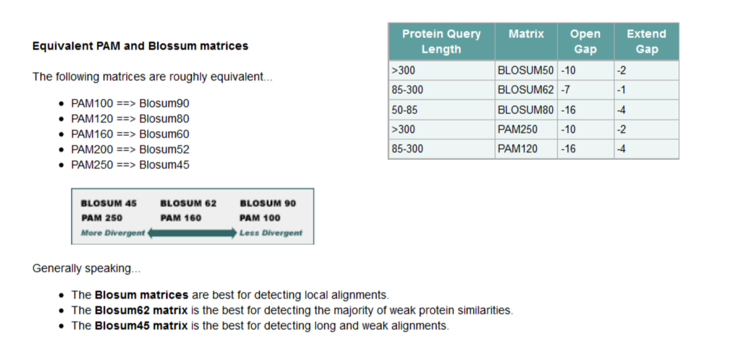
PAMx: la probabilità con cui ogni aminoacido subisce x sostituzioni su 100 amino acidi (percentuale di mutazioni accettate).
BLOSUMx: osservando sequenze con almeno x% identità e valuto la «distanza» tra le altre.

Slide 65
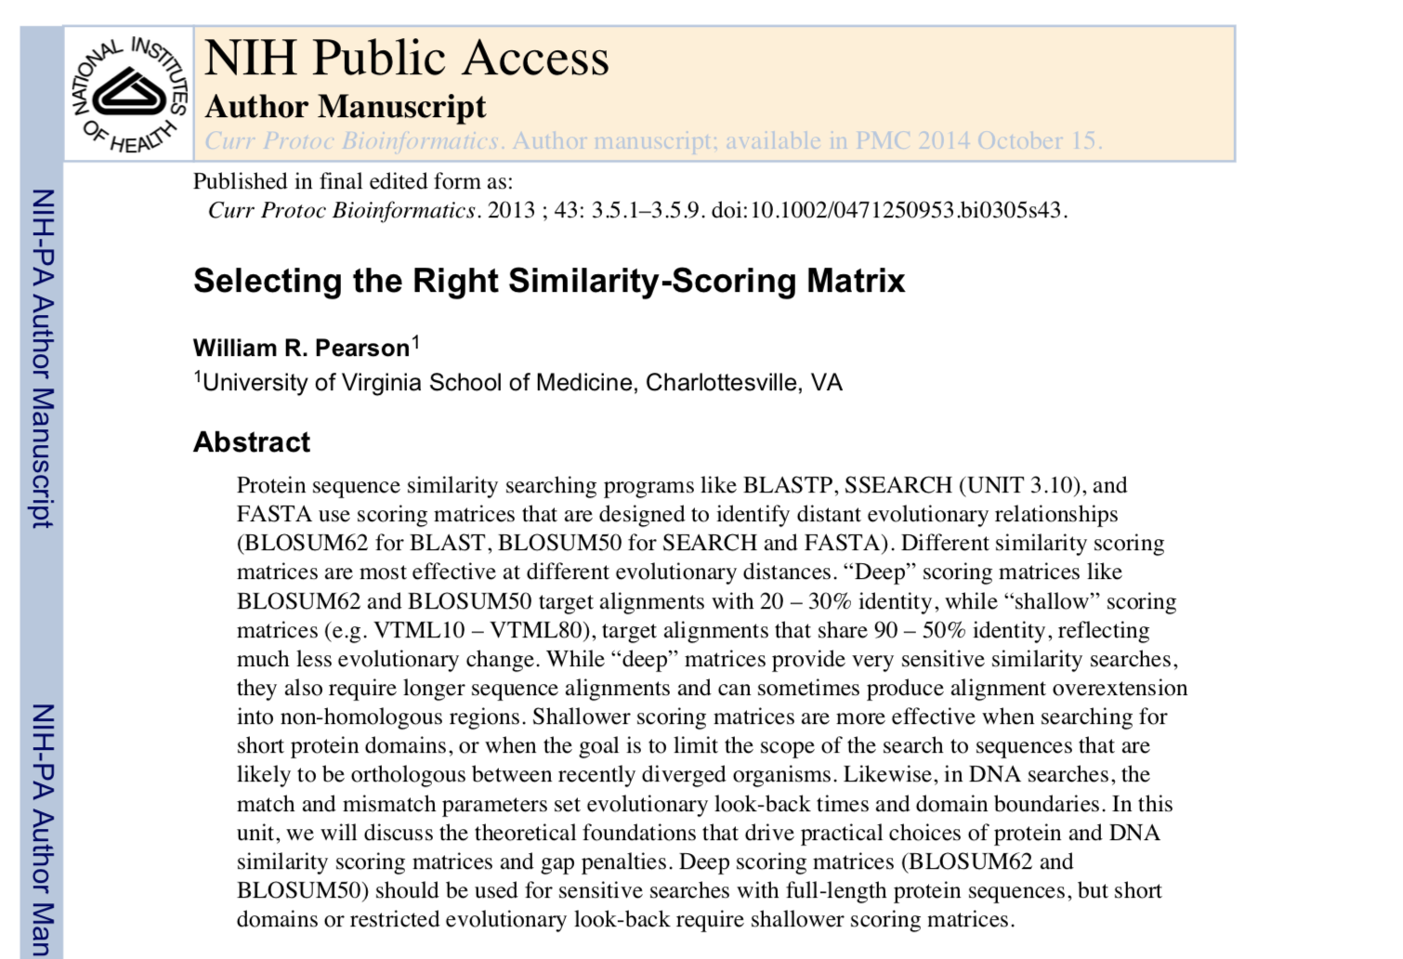

Slide 66
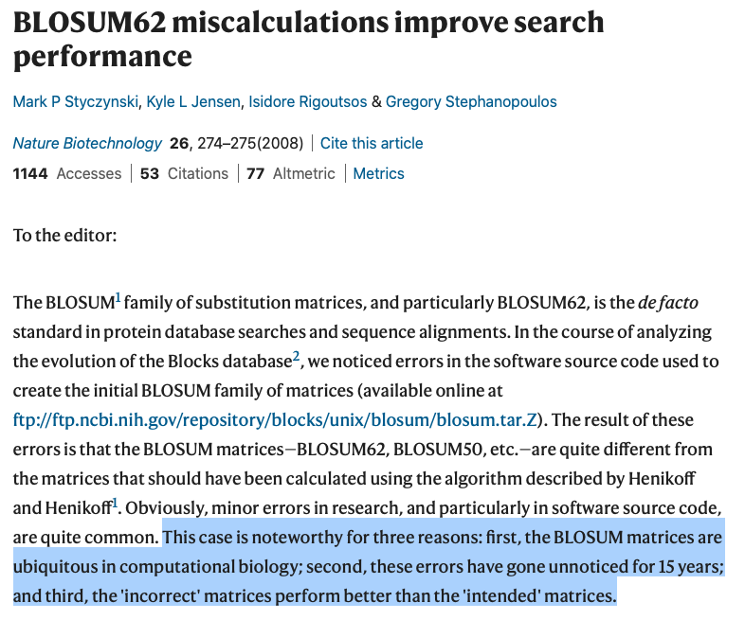
A Quick Aside About the BLOSUM Scoring Matrices

Slide 67
Strengthening Global Alignment
Global Alignment Problem: Find a highest-scoring alignment of two strings.
Input: Two strings and a scoring matrix.
Output: An alignment of the strings with maximum alignment score according to the scoring matrix.
STOP: How does this change the alignment graph?

Slide 68
Strengthening Global Alignment
Global Alignment Problem: Find a highest-scoring alignment of two strings.
Input: Two strings and a scoring matrix.
Output: An alignment of the strings with maximum alignment score according to the scoring matrix.
Answer: Every edge simply gets weighted with the cost of the corresponding scoring matrix value.

Slide 69
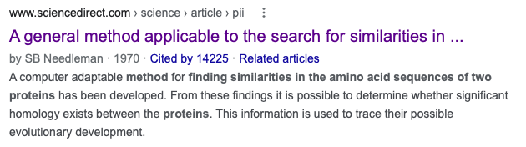
Summarizing our Global Alignment Algorithm
Form a 2-D array using the recurrence relation for dynamic programming.
Create array containing “backtracking pointers”.
After reaching the sink, backtrack to source to produce a maximum-weight path.
Infer the alignment corresponding to this path.

Slide 70
Summarizing our Global Alignment Algorithm
STOP (biologists): Would you rather align two genes as DNA strings (nucleotides) or as proteins (amino acids)?

Slide 71
Summarizing our Global Alignment Algorithm
Answer: If we know that the genes wind up as protein, then a protein-level function will be more informative since there is a larger alphabet and the amino acids determine function of the protein.

Slide 72
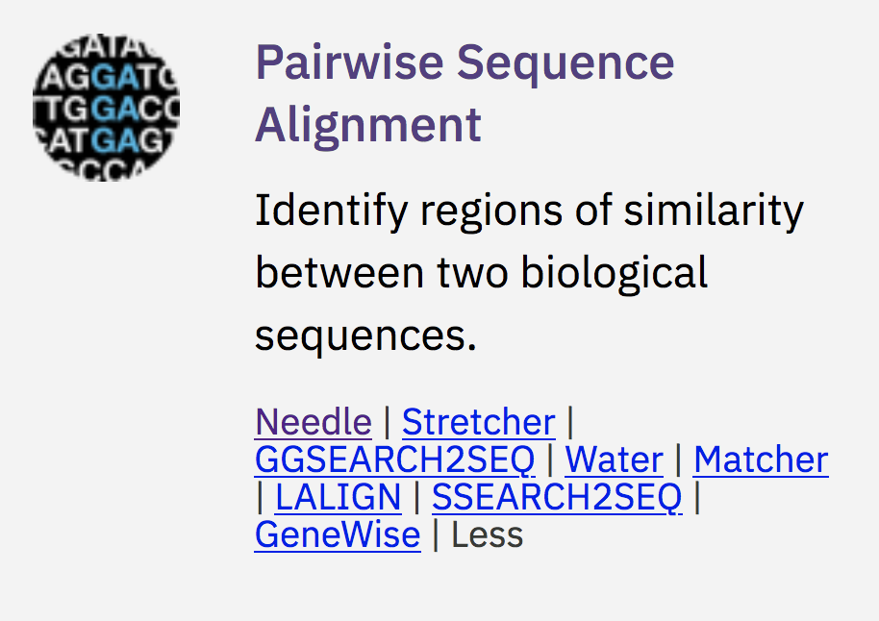
Applying to Real Data
STOP: Let’s apply this to the same protein (say, hemoglobin subunit alpha) in a few different species. What do you think we will see?
Homo sapiens vs. Gorilla gorilla gorilla
Homo sapiens vs. Bos Taurus (cow)
Homo sapiens vs. Danio rerio (zebrafish)
Homo sapiens: https://www.uniprot.org/uniprot/P69905
Gorilla gorilla gorilla: https://www.uniprot.org/uniprot/P01923
Bos taurus: https://www.uniprot.org/uniprot/P01966
Danio rerio: https://www.uniprot.org/uniprot/Q90487
EMBOSS “Needle” server:
https://www.ebi.ac.uk/jdispatcher/psa/emboss_needle

Slide 73
Piccola esercitazione
Abbiamo interrogato Needle al link indicato nella slide precedente
Abbiamo inserito due sequenze ottenute dai link indicati nell’elenco (vedi slide successiva)
Abbiamo eseguito il tool di confronto e abbiamo visualizzato il risultato

Slide 74
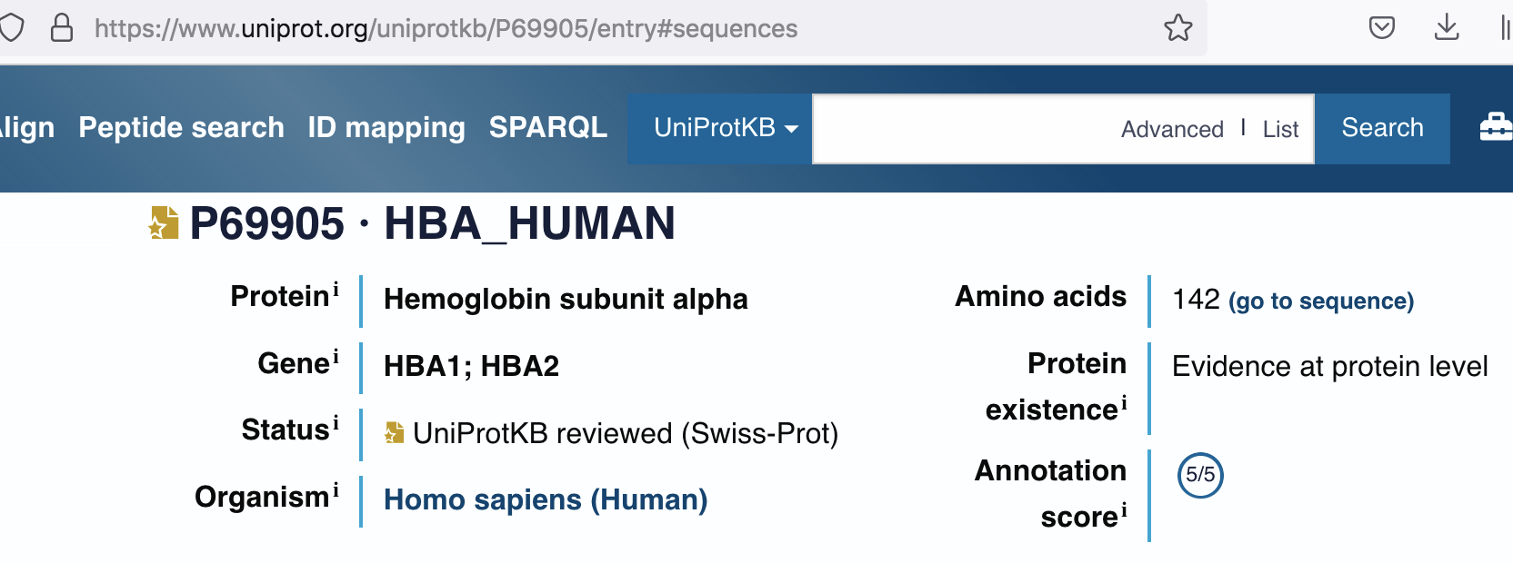
and copy

Slide 75
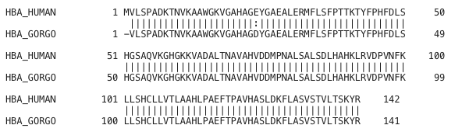
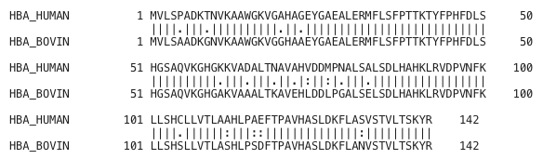
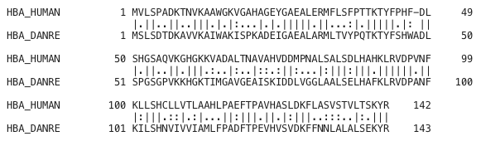
Results of Hemoglobin Alignments
Note: “|” means exact similarity, “:” means strong similarity, and “.” means weak similarity.
STOP: What is our hypothesis?

Slide 76
Biology 1963
From the point of view of hemoglobin structure, it appears that gorilla is just an abnormal human.
...that is of course nonsense. What the comparison really indicates is that hemoglobin is a bad choice and has nothing to tell us about attributes.
Émile Zuckerkandl
Gaylord Simpson

Slide 77
From Global to Local Alignment

Slide 78
Which Alignment is Better?
Alignment 1: score = 22 (matches) - 20 (indels)=2.
Alignment 2: score = 17 (matches) - 30 (indels)=-13.
GCC-C-AGT--TATGT-CAGGGGGCACG--A-GCATGCAGA-
GCCGCC-GTCGT-T-TTCAG----CA-GTTATG--T-CAGAT
---G----C-----C--CAGTTATGTCAGGGGGCACGAGCATGCAGA
GCCGCCGTCGTTTTCAGCAGTTATGTCAG-----A------T-----
local alignment
this alignment has lower score, but it is more biologically relevant [local alignnment]

Slide 79
Local Alignment Problem
Local Alignment Problem: Find the highest-scoring local alignment between two strings.
Input: Strings v and w as well as a matrix score.
Output: Substrings of v and w whose global alignment (as defined by the matrix score), is maximal among all global alignments of all substrings of v and w.

Slide 80
Visualizing Local Alignments
Local alignments may be well away from “main diagonal” because they have a lot of indels on ends of the alignment.

Slide 81
Revisiting Global Alignment for Local Alignment
Global Alignment Problem:
Input: Two strings and a scoring matrix.
Output: An alignment of the strings with maximum alignment score according to the scoring matrix.
STOP: How can we reformulate the problem statement to find areas of “local” similarity?

Slide 82
Revisiting Global Alignment
Local Alignment Problem:
Input: Two strings v and w and a scoring matrix.
Output: Substrings of v and w whose best global alignment score is maximized over all substrings.
STOP: One idea for solving this is to solve the Global Alignment Problem for every pair of substrings of v and w. Why is this an issue?

Slide 83
Revisiting Global Alignment
Local Alignment Problem:
Input: Two strings v and w and a scoring matrix.
Output: Substrings of v and w whose best global alignment score is maximized over all substrings.
Answer: We have about |v|²|w|² alignments to construct!
This was understood in 1970, and yet the problem remained open …

Slide 84
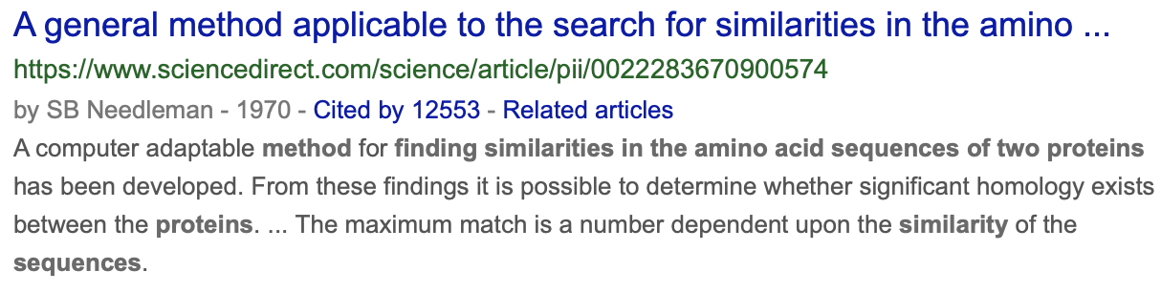
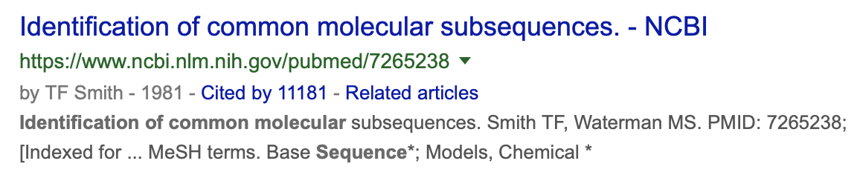
Ten Years Go By …

Slide 85
“Free Rides” for Local Alignment
Add a zero-weight edge from the source to every node and the sink to every node.
0
This will allow a local alignment to start and end anywhere with no penalty.
0

Slide 86
What Do Free Taxi Rides Mean in the Terms of the Alignment Graph?
Notes:
scratch

Slide 87
Building Manhattan for the Local Alignment Problem
How many edges have we added?
Notes:
scratch

Slide 88
“Free Rides” for Local Alignment
STOP: Recall that the dynamic programming algorithm has runtime proportional to the number of edges in the network. How many zero-weight edges did we add?
0
0
Answer: Just ~2nm. ☺

Slide 89
“Free Rides” for Local Alignment
What is the recurrence relation for the local alignment problem?
0
0

Slide 90
Dynamic Programming for the Local Alignment
weight of edge from (0,0) to (i,j)
s_{i-1, j} + weight of edge “↓” into (i,j)
s_{i, j-1} + weight of edge “→” into (i,j)
s_{i-1, j-1}+ weight of edge “↘” into (i,j)
{
s_{i, j}= max

Slide 91
Dynamic Programming for the Local Alignment
0
s_{i-1, j} + weight of edge “↓” into (i,j)
s_{i, j-1} + weight of edge “→” into (i,j)
s_{i-1, j-1}+ weight of edge “↘” into (i,j)
{
s_{i, j}= max

Slide 92
“Free Rides” for Local Alignment
Answer: It is given by
where the scores here are –σ, –σ, and either +1 or –μ (depending on a match vs. a mismatch).
0
0

Slide 93
“Free Rides” for Local Alignment
Exercise: After we apply the recurrence, where should we start backtracking? (That is, where does the best local alignment end?)
0
Answer: Wherever the maximum value of the scoring table is.
0

Slide 94
The Solution to a Problem Unsolved for Ten Years Nearly Fits on One Slide

Slide 95
The Solution to a Problem Unsolved for Ten Years Nearly Fits on One Slide

Slide 96
How Do We Compare Biological Sequences
From Sequence Comparison to Biological Insights
The Alignment Game and the Longest Common Subsequence
The Manhattan Tourist Problem
Dynamic Programming and Backtracking Pointers
From Manhattan to the Alignment Graph
From Global to Local Alignment
Penalizing Insertions and Deletions in Sequence Alignment
Space-Efficient Sequence Alignment
Multiple Sequence Alignment
7 gap separati, potrebbero essere non equivalenti a 7 gap contigui (gap evolutivo)

Slide 97

How Do We Compare Biological Sequences
From Sequence Comparison to Biological Insights
The Alignment Game and the Longest Common Subsequence
The Manhattan Tourist Problem
Dynamic Programming and Backtracking Pointers
From Manhattan to an Arbitrary Directed Acyclic Graph
From Global to Local Alignment
Penalizing Insertions and Deletions in Sequence Alignment
Space-Efficient Sequence Alignment
Multiple Sequence Alignment

Slide 98
Breve riepilogo dei due algoritmi di PD
Vengono tipicamente descritti non usando
la griglia, ma una matrice (da non confondersi però con la matrice di allineamento).
a completamento della descrizione dei due problemi di allineamento (globale/locale) vi inserisco queste slides su 8 problemi riconducibili ai due che abbiamo visto insieme.

Slide 99
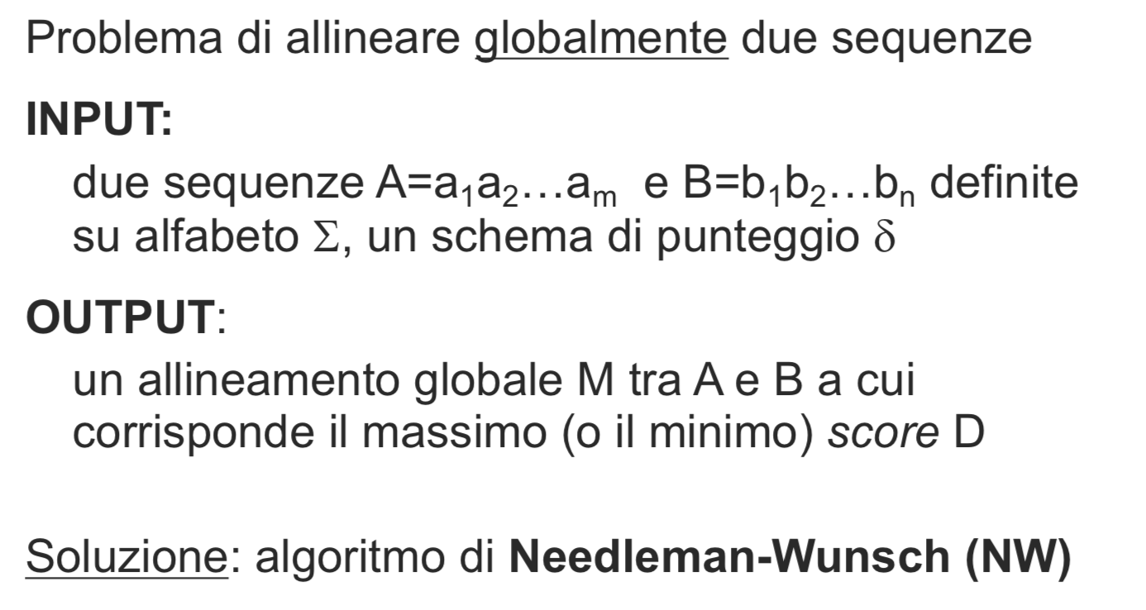
Allineamento globale

Slide 100
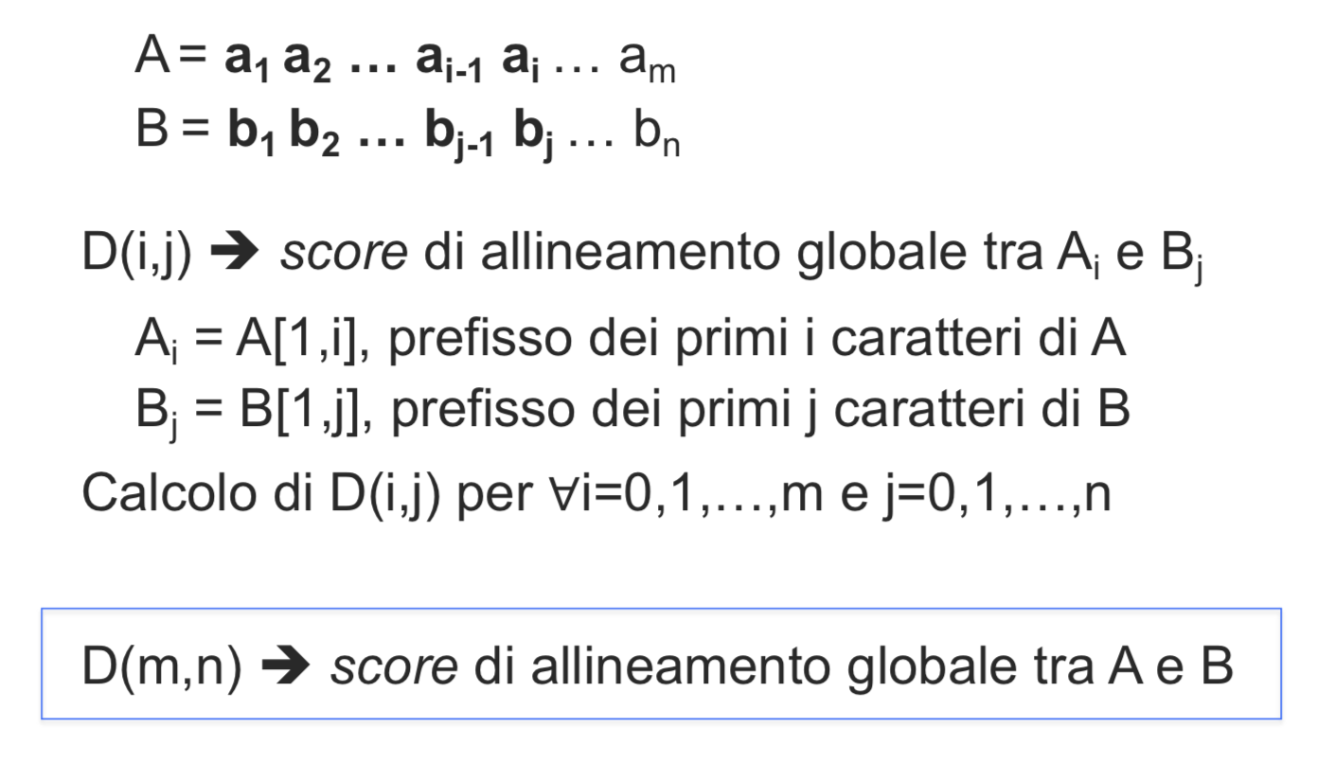
Allineamento globale

Slide 101
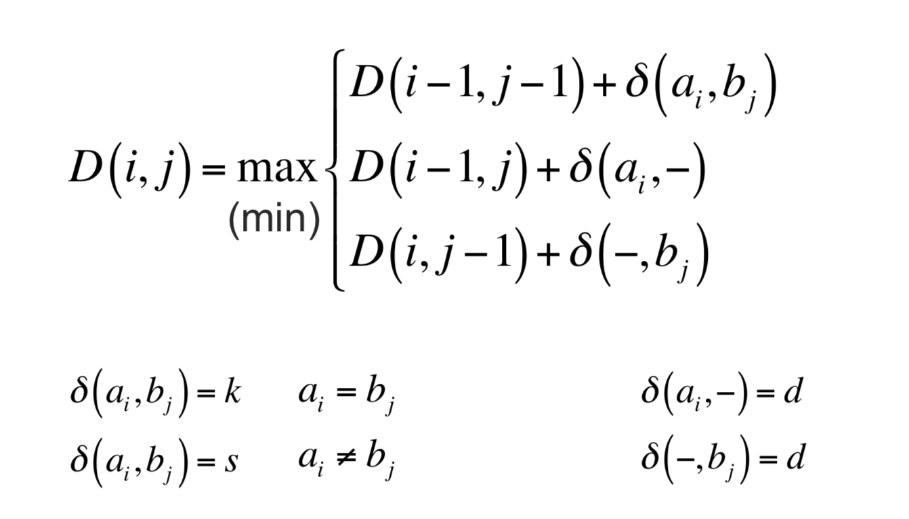
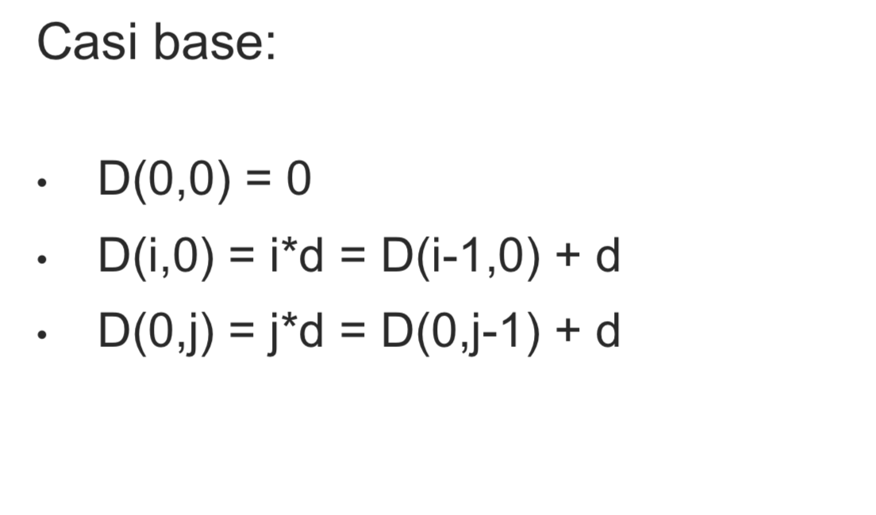
Allineamento globale
k costo per il match
s costo per il mismatch
d cost per indel

Slide 102
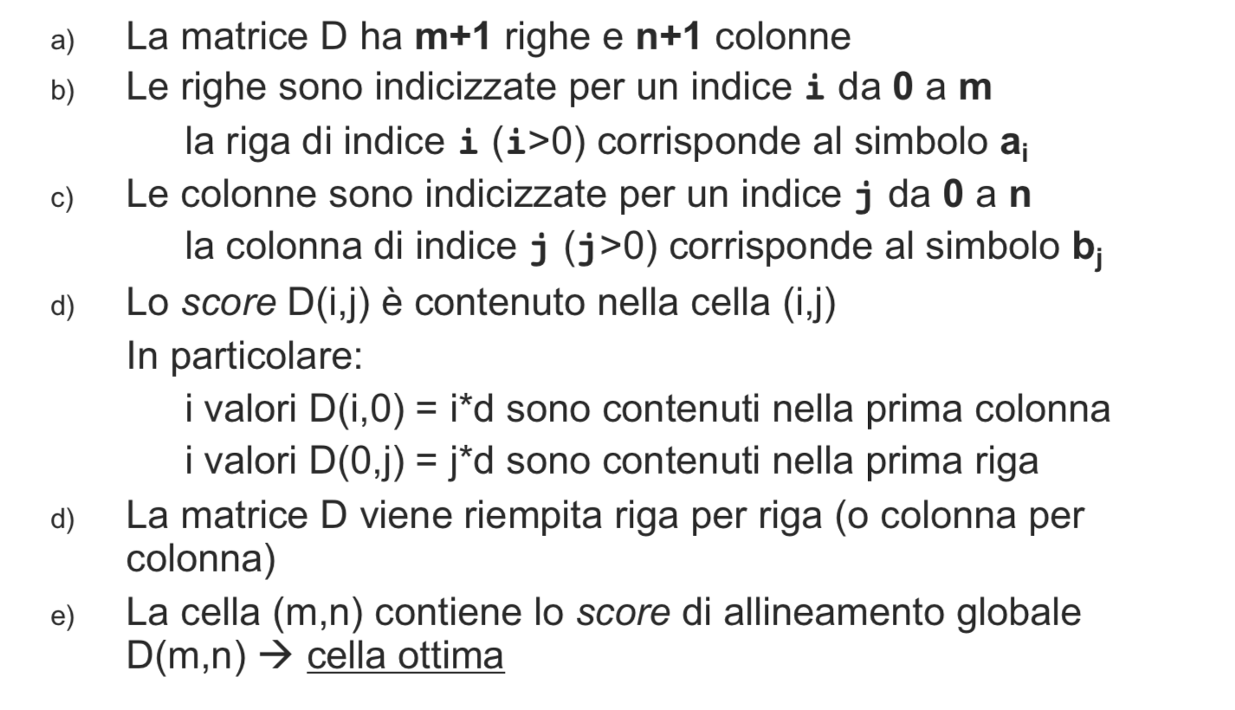
Allineamento globale

Slide 103
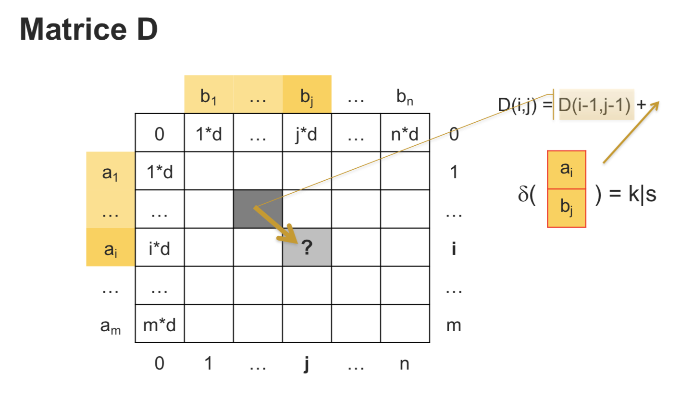
Allineamento globale

Slide 104
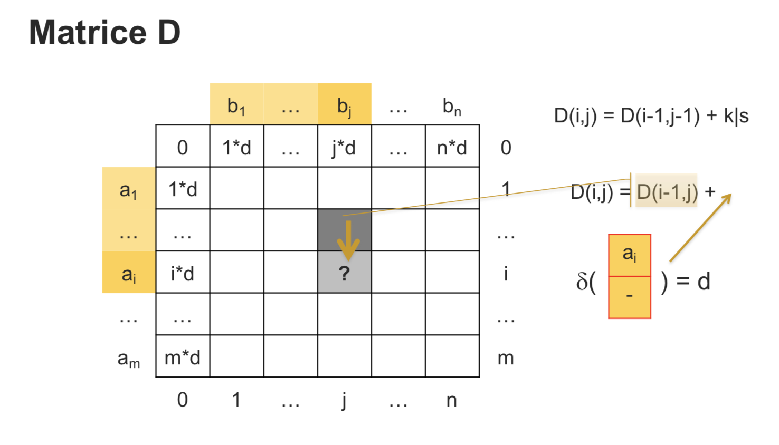
Allineamento globale

Slide 105
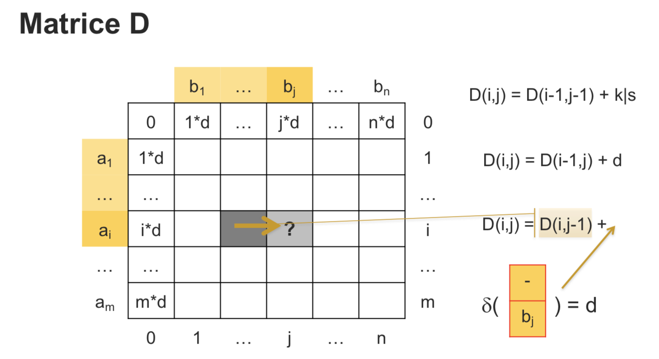
Allineamento globale

Slide 106
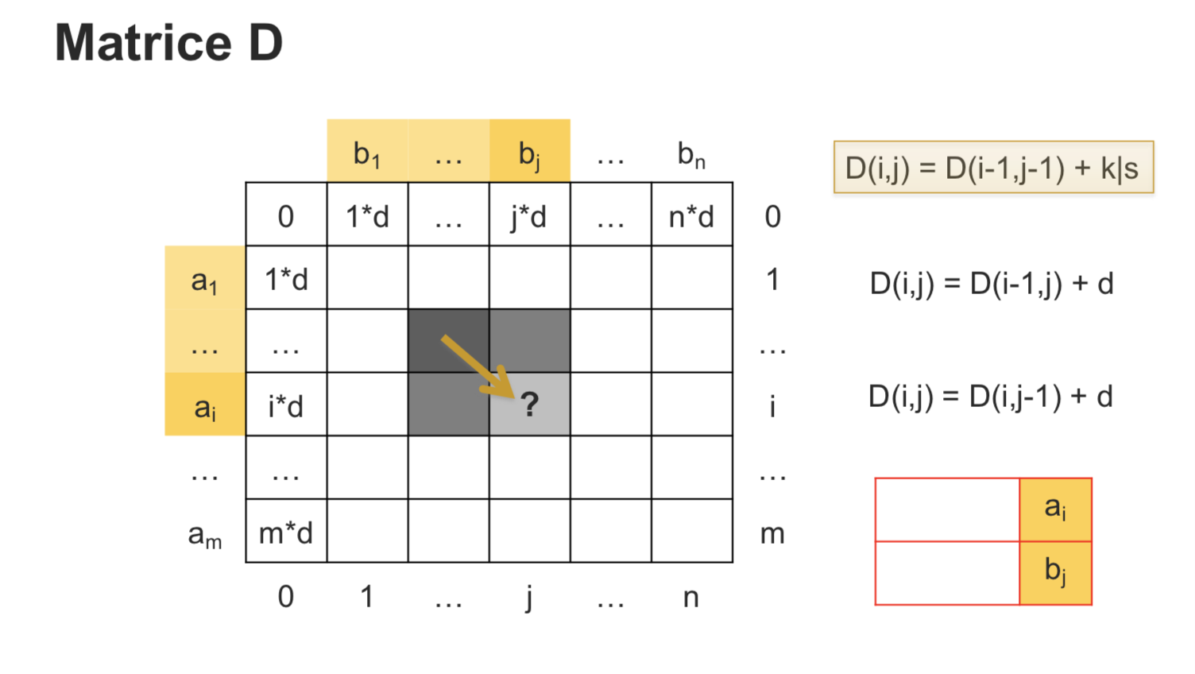
Allineamento globale

Slide 107
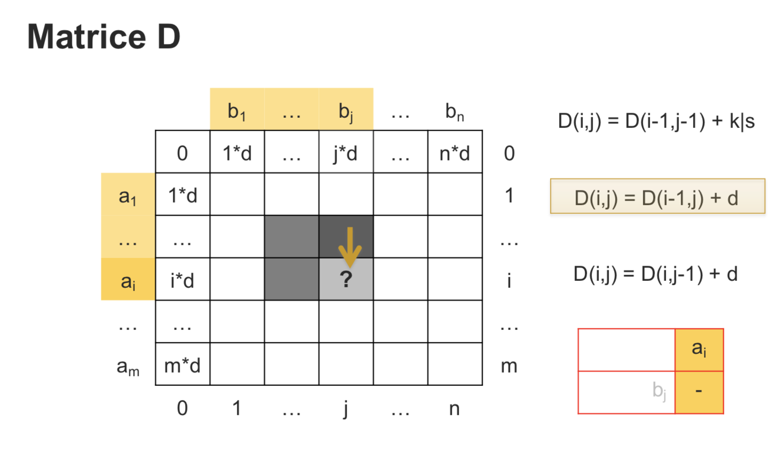
Allineamento globale: ricostruzione

Slide 108
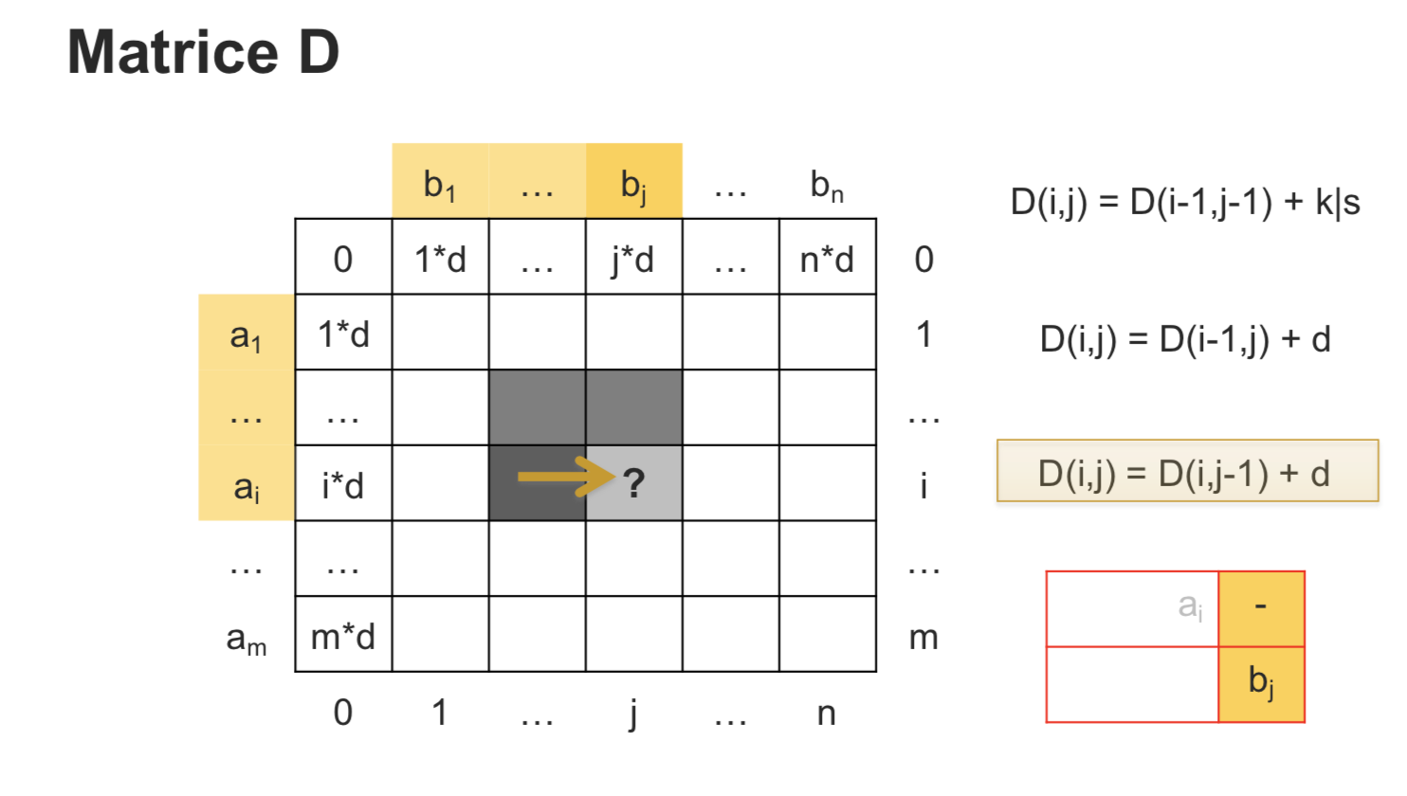
Allineamento globale: ricostruzione

Slide 109
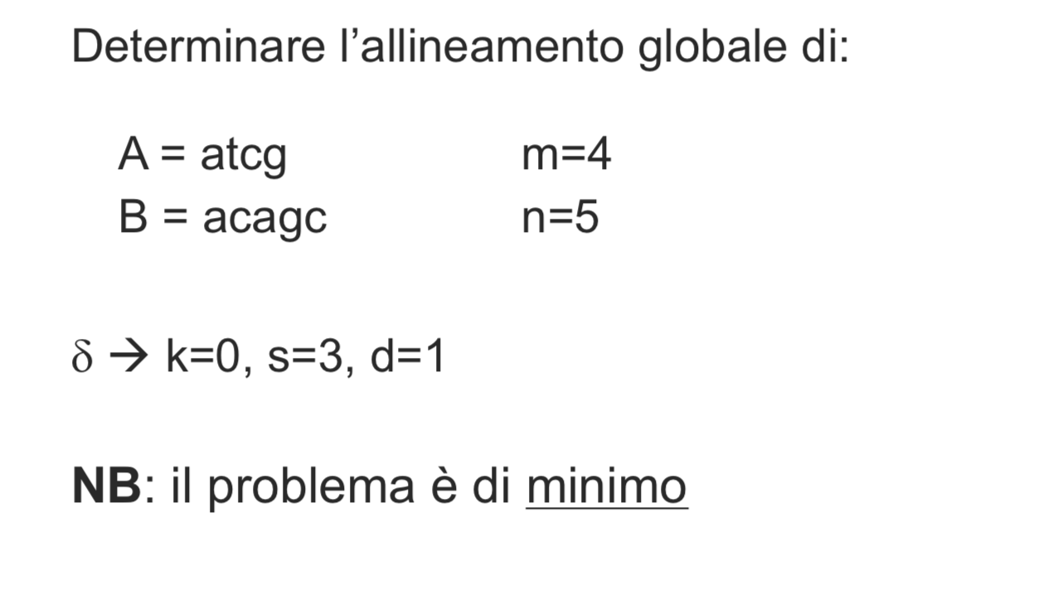
Esempio
lo capisco guardando i pesi…

Slide 110
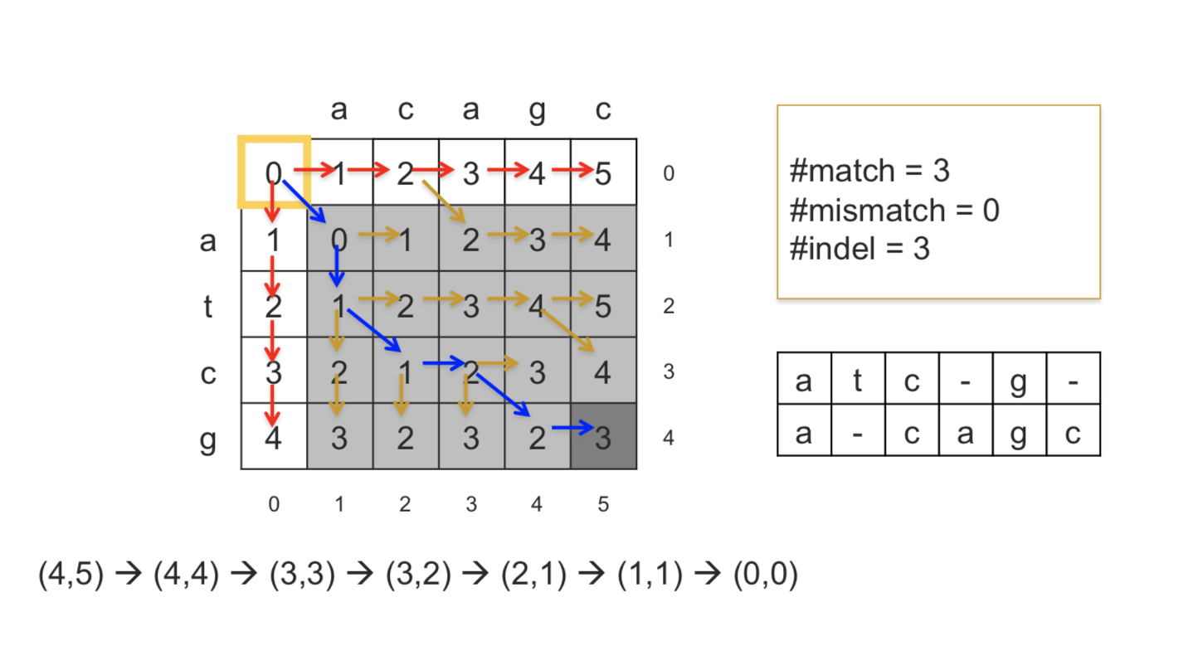
Esempio

Slide 111
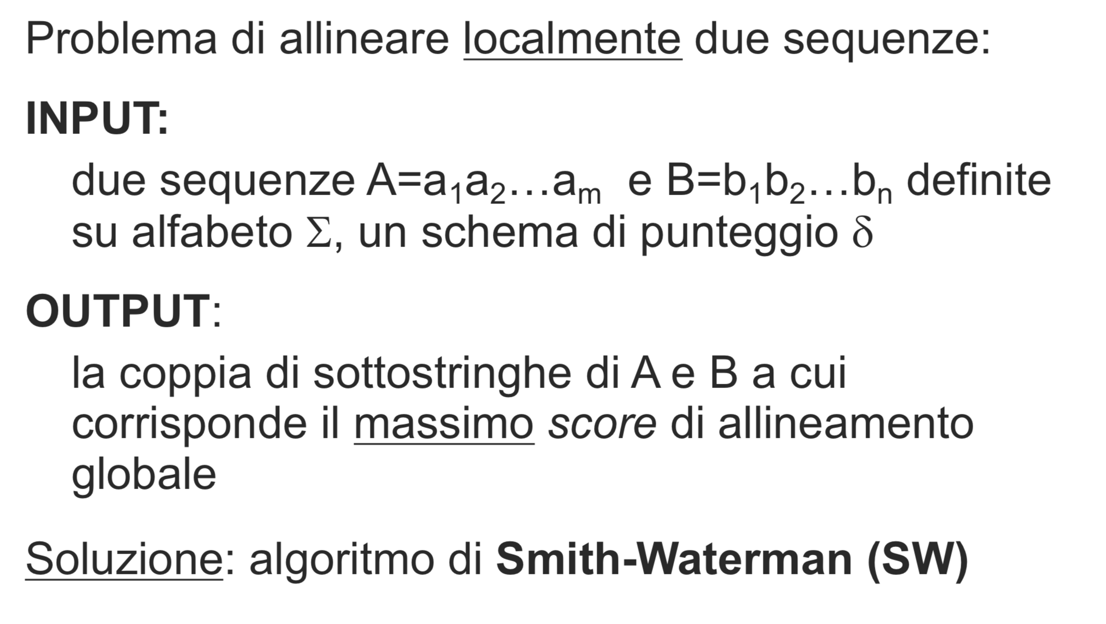
Allineamento locale

Slide 112
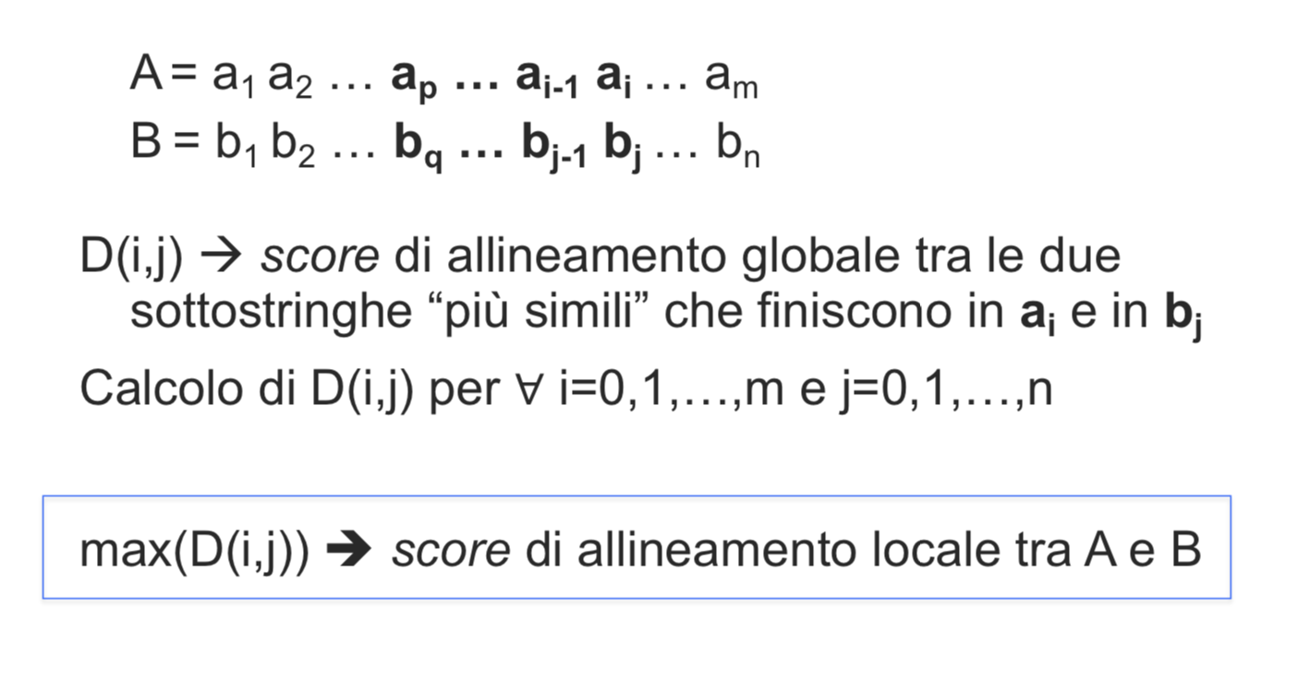
Allineamento locale

Slide 113
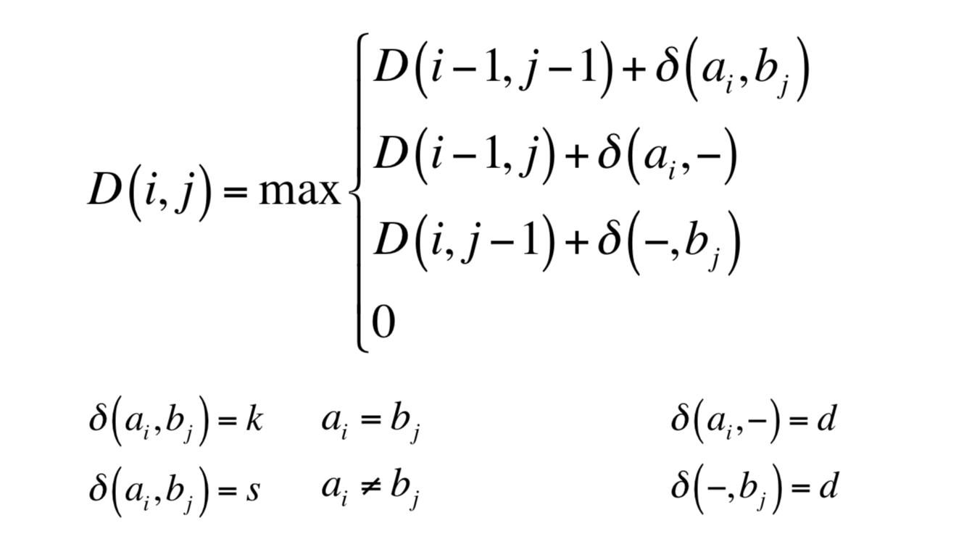
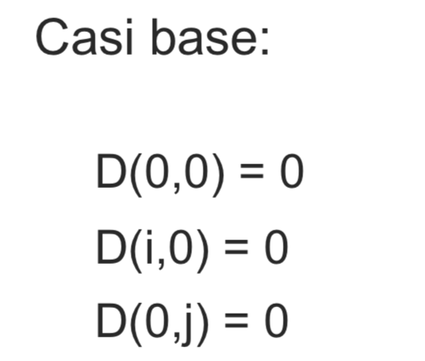
Allineamento locale

Slide 114
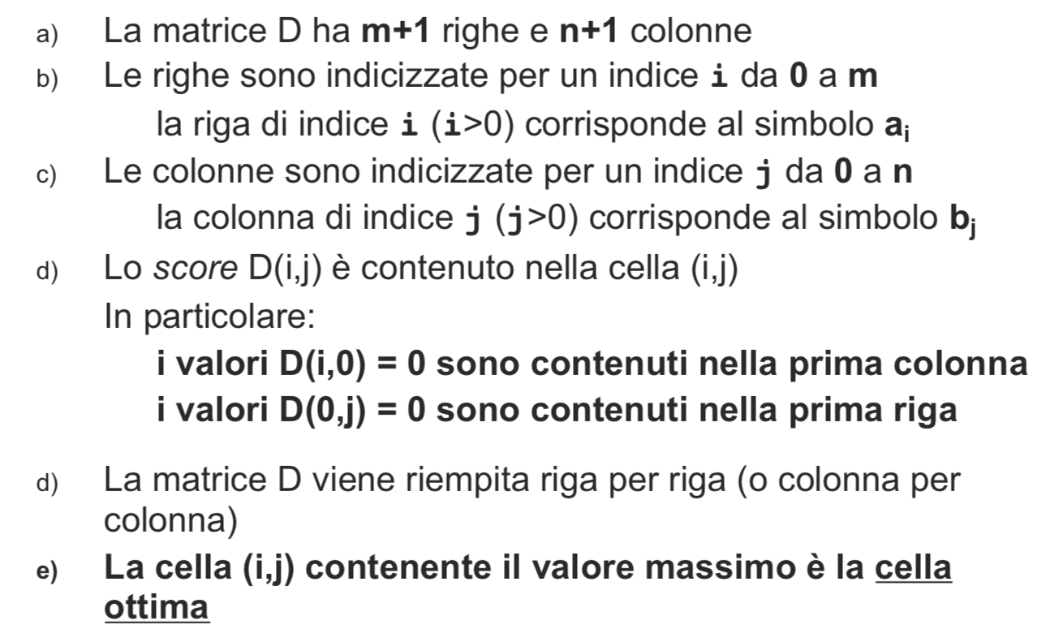
Allineamento locale

Slide 115
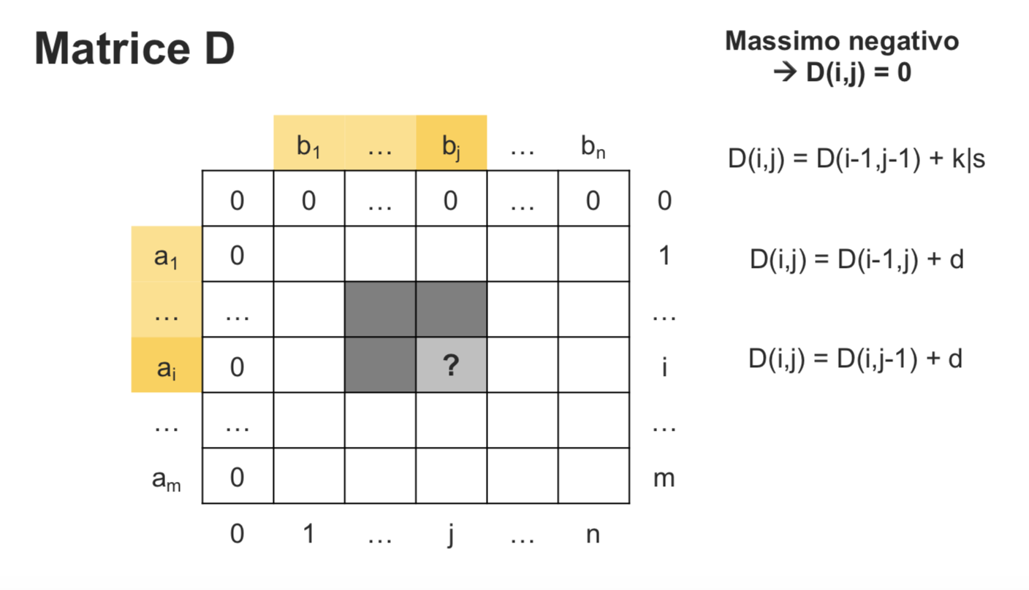
Allineamento locale

Slide 116
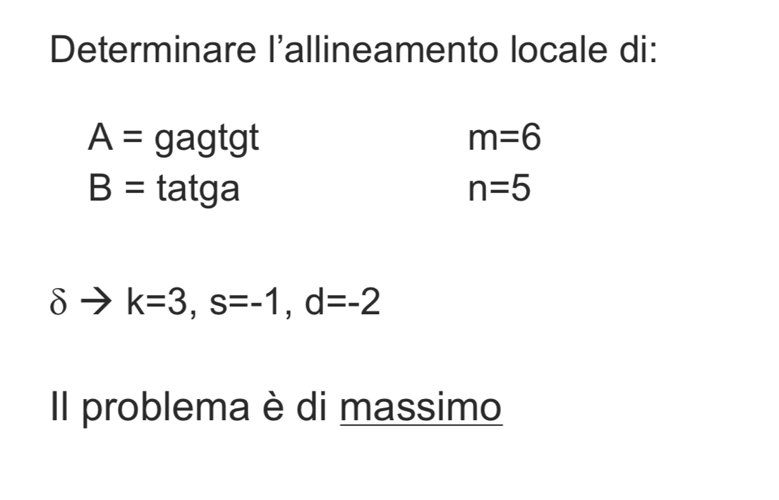
Esempio

Slide 117
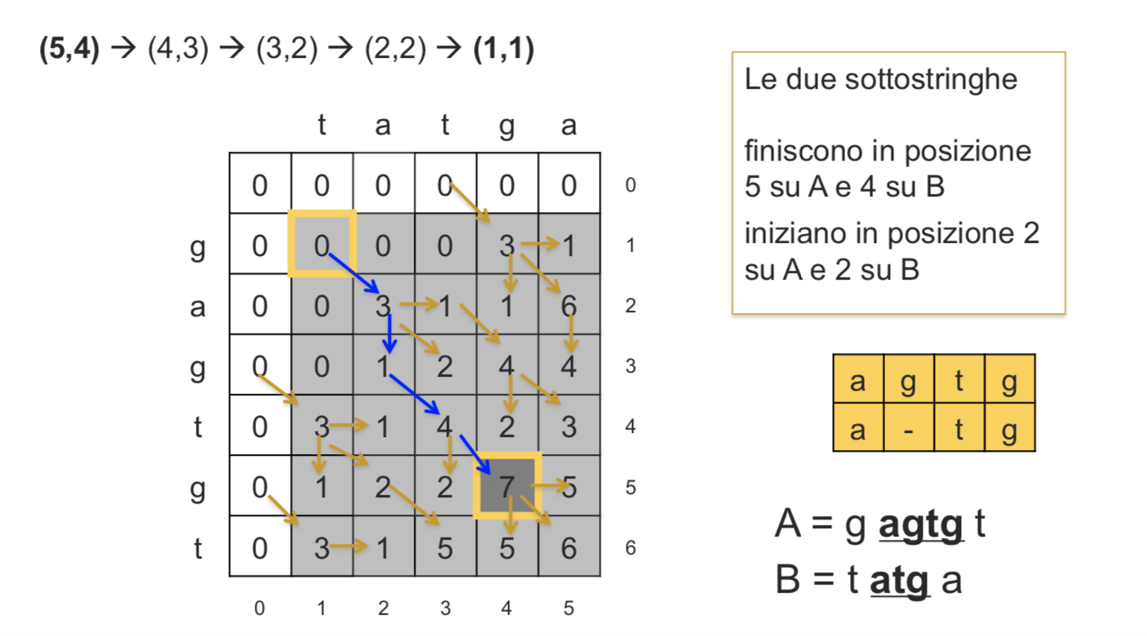
Esempio

Slide 118
8 problemi
Presentiamo 8 problemi che sono varianti dei classici NW e SW o mix di essi.
Possono essere formulati ovviamente anche scambiando il ruolo di A e B,

Slide 119
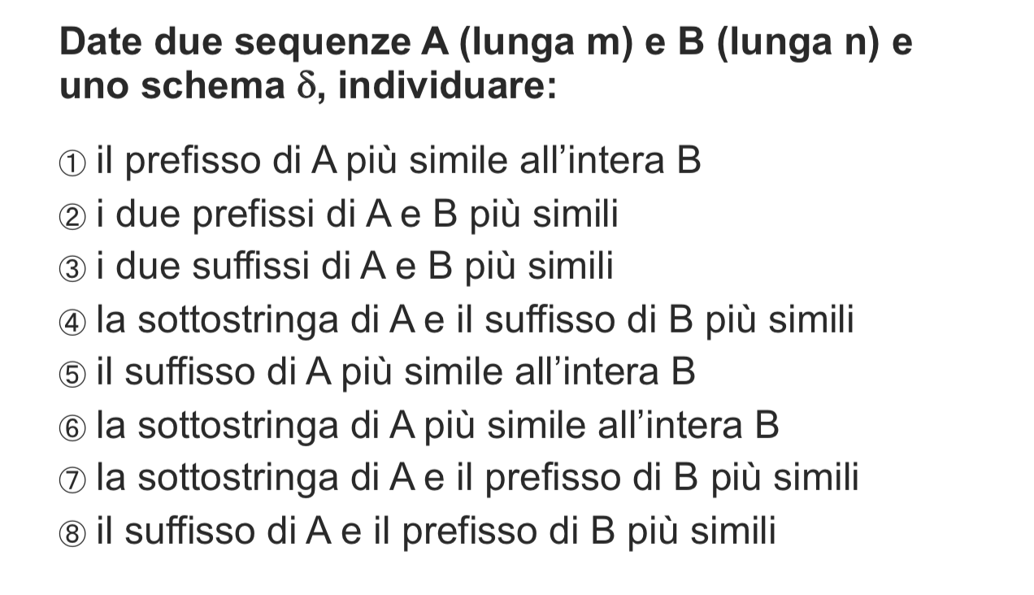
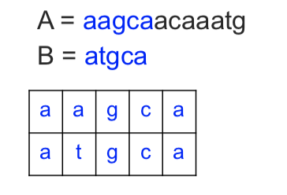
8 problemi
SOLUZIONE: definisco s(i,j) score di allineamento globale tra A_{i} e B_{j}
s(i,n) è lo score di allineamento globale tra A_{i} e B
i_{max}, tale che s(i_{max},n) è massimo
è posizione di fine su A del prefisso che ha il massimo score di allineamento globale con l’intera sequenza B
NW con valore ottimo uguale al massimo della colonna n della matrice s degli scores [casi base: s(0,0)=0; s(0,j)=j*d per ogni j; s(i,0)=i*d per ogni i]

Slide 120
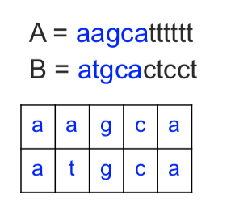
8 problemi
SOLUZIONE: definisco s(i,j) score di allineamento globale tra A_{i} e B_{j}
i_{max}, j_{max}, tale che s(i_{max}, j_{max}, ) è massimo
è posizione di fine su A e su B dei prefissi che ha il massimo score di allineamento
NW con valore ottimo uguale al massimo nella matrice s degli scores [casi base: s(0,0)=0; s(0,j)=j*d per ogni j; s(i,0)=i*d per ogni i]

Slide 121
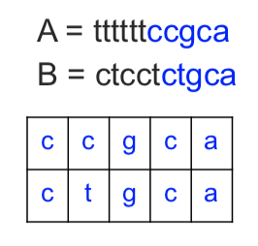
8 problemi
SOLUZIONE: s(i,j) è lo score di allineamento globale tra le due sottostringhe più simili che finiscono in posizione i su A e in posizione j su B
s(m,n) è lo score di allineamento globale tra due suffissi più simili. La cella di STOP per la ricostruzione sarà il primo 0 che incontro nella visita backtrack.
SW con valore ottimo uguale al valore della cella (m,n) degli scores [casi base: s(0,0)=0; s(0,j)=0 per ogni j; s(i,0)=0 per ogni i]

Slide 122
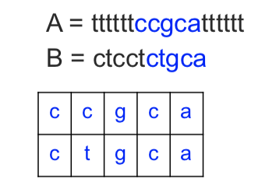
8 problemi
SOLUZIONE: s(i,j) è score di allineamento globale tra le due sottostringhe più simili che finiscono in posizione i su A e in posizione j su B
i_{max} tale che s(i_{max}, n) è massimo
è la posizione di fine su A della sottostringa su A più simile a un suffisso di B. STOP per la ricostruzione sarà il primo 0 che incontro nella visita backtrack.
SW con valore ottimo uguale al massimo della colonna n della matrice s degli scores [casi base: s(0,0)=0; s(0,j)=0 per ogni j; s(i,0)=0 per ogni i]

Slide 123
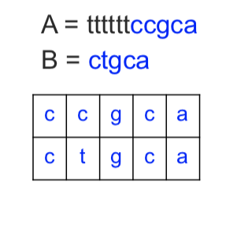
8 problemi
SOLUZIONE: s(i,j) score di allineamento globale della sottostringa di A che finisce in posizione i e il prefisso di B che termina in posizione j che sono più simili
s(m, n) è lo score di allineamento globale tra l’intera sequenza B e il suffisso più simile di A. STOP per la ricostruzione sarà il primo 0 che incontro nella visita backtrack nella prima colonna.
NW con valore ottimo uguale al valore della cella s(m,n) [ma casi base modificati: s(0,0)=0; s(0,j)=j*d per ogni j (se deve terminare in j ho j delezioni); s(i,0)=0 per ogni i (è la stringa nulla)]

Slide 124

8 problemi
SOLUZIONE: s(i,j) score di allineamento globale della sottostringa di A che finisce in posizione i e il prefisso di B che termina in posizione j che sono più simili.
s(i, n) è lo score di allineamento globale tra l’intera sequenza B e la sottostringa più simile di A.
i_{max}, tale che s(i_{max}, n) è massimo
è la posizione di fine su A della sottostringa più simile a B
STOP al primo 0 che incontro nella prima colonna.
NW con valore ottimo uguale al valore massimo nella colonna n [ma casi base modificati: s(0,0)=0; s(0,j)=j*d per ogni j (se deve terminare in j ho j delezioni); s(i,0)=0 per ogni i (è la stringa nulla)]

Slide 125

8 problemi
SOLUZIONE: s(i,j) score di allineamento globale della della sottostringa di A che finisce in posizione i e il prefisso di B che termina in posizione j che sono più simili
i_{max}, j_{max}, tale che s(i_{max}, j_{max}, ) è massimo
posizione di fine su A e su B della sottostringa e del prefisso più simili
STOP al primo 0 che incontro nella prima colonna.
NW con valore ottimo uguale al valore massimo nella matrice s [ma casi base modificati: s(0,0)=0; s(0,j)=j*d per ogni j (se deve terminare in j ho j delezioni); s(i,0)=0 per ogni i (è la stringa nulla)]

Slide 126

8 problemi
SOLUZIONE: s(i,j) score di allineamento globale della sottostringa di A che finisce in posizione i e il prefisso di B che termina in posizione j che sono più simili
s(m,j) è lo score di allineamento globale tra il prefisso di B che finisce in posizione j e il suffisso di A che sono più simili
j_{max}, tale che s(m, j_{max}, ) è massimo
è la posizione di fine su B del prefisso più simile a un suffisso di A
STOP al primo 0 che incontro nella prima colonna.
NW con valore ottimo uguale al valore massimo nell’ultima riga nella matrice s [ma casi base modificati: s(0,0)=0; s(0,j)=j*d per ogni j (se deve terminare in j ho j delezioni); s(i,0)=0 per ogni i (è la stringa nulla)]

